Slide 1

What are the Dutch municipalities that have an average household income above EUR 40000?
Utrecht Summer School:
Programming with Python 2023
All icons by: https://www.flaticon.com/

Slide 2
Unit 3.2:
CSV files, Pandas, tabular data
Utrecht Summer School:
Programming with Python 2023
All icons by: https://www.flaticon.com/

Slide 3

Previous lecture
Object-Oriented Programming

Slide 4

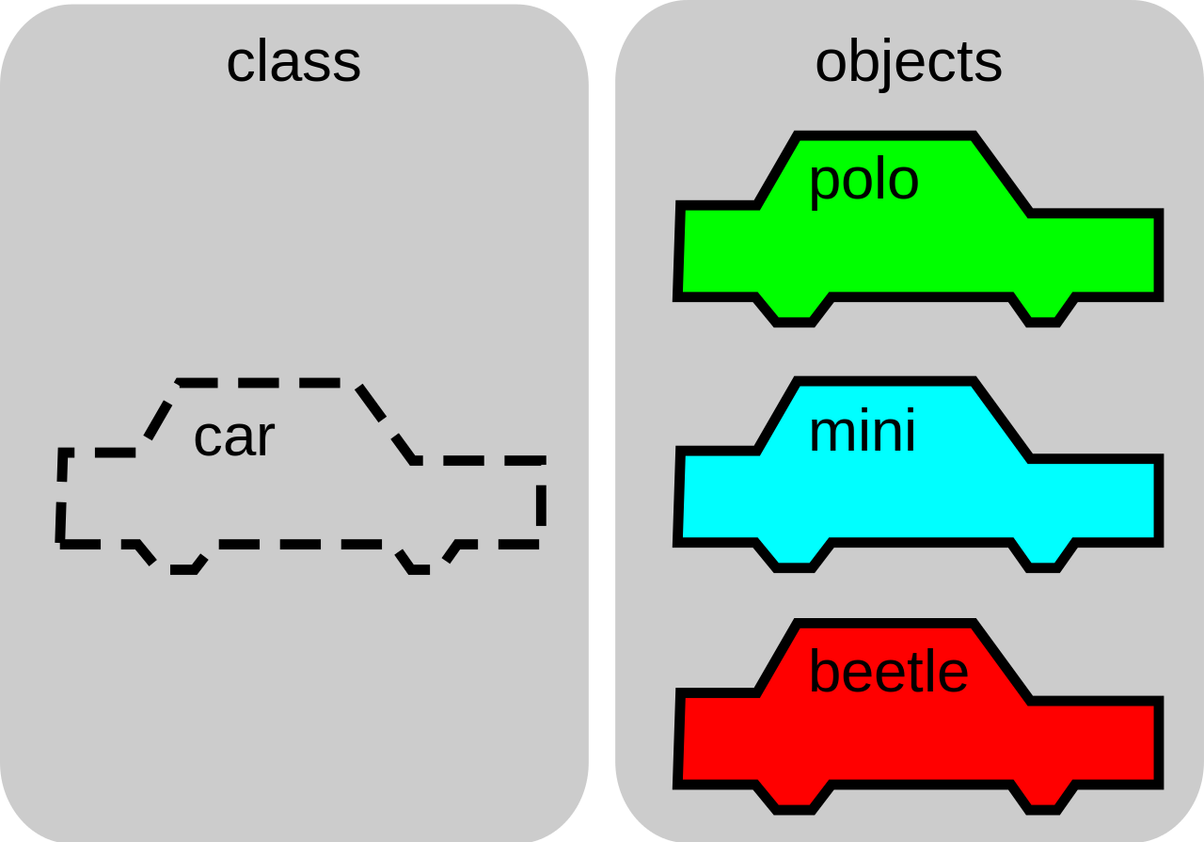
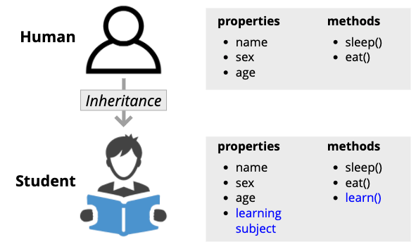

Slide 5


Today’s lecture

Slide 6
Today’s lecture
string
int

Slide 7
Today’s lecture
string
int
for
while

Slide 8
Today’s lecture
string
int
for
data structures
while
functions
functions

Slide 9

Today’s lecture
string
int
for
data structures
while
functions
functions

Slide 10

Today’s lecture
string
int
for
data structures
while
functions
functions

Slide 11

Today’s lecture
string
int
for
data structures
while
functions
functions

Slide 12
Today’s lecture
DATA
INFORMATION

Slide 13
What are the Dutch municipalities that have an average household income above EUR 40000?
Utrecht Summer School:
Programming with Python 2023
All icons by: https://www.flaticon.com/
Notes:
Take ideas and write them down
If they mention ChatGPT, show them my attempts and these notes:
Problems with ChatGPT:
- format
- froze
- refused to give answer
- adapted question means making the query again
- data might be private

Slide 14
Today’s lecture
Reading and Writing Files
CSV Files
Notes:
At this point, stop the presentation, open the dataset file, and pose the question again: What are the Dutch municipalities that have an average household income above EUR 40000?
What are the challenges now?

Slide 15
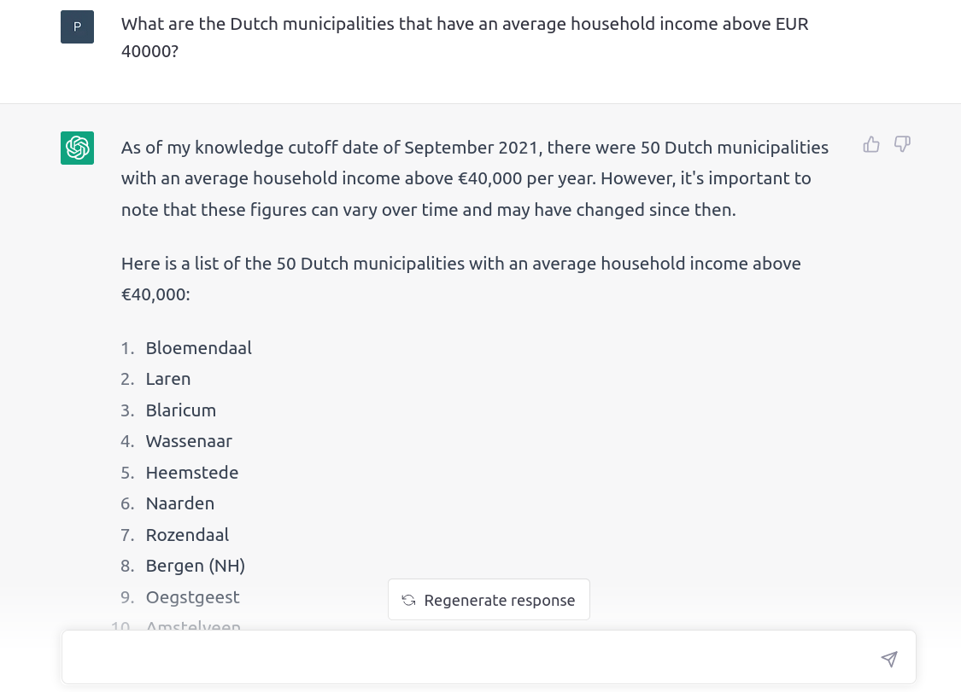
Notes:
At this point, stop the presentation, open the dataset file, and pose the question again: What are the Dutch municipalities that have an average household income above EUR 40000?
What are the challenges now?

Slide 16
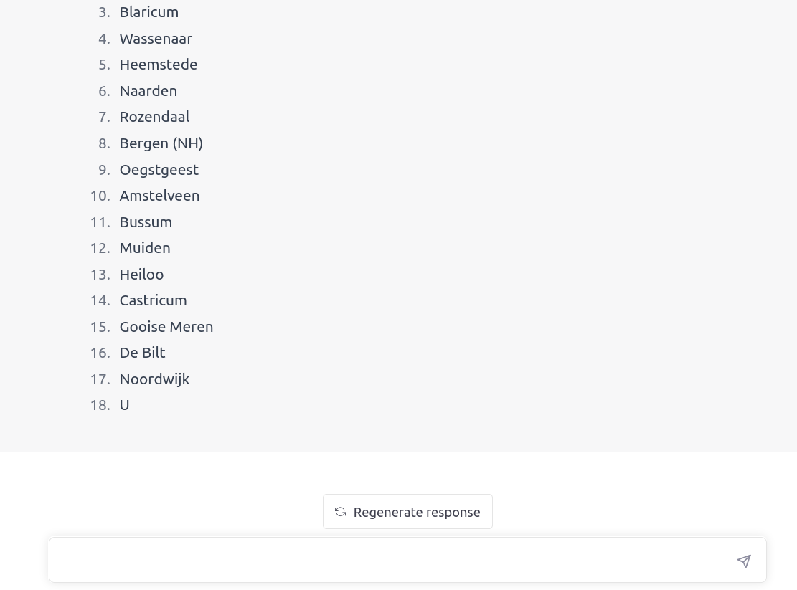
Notes:
At this point, stop the presentation, open the dataset file, and pose the question again: What are the Dutch municipalities that have an average household income above EUR 40000?
What are the challenges now?

Slide 17
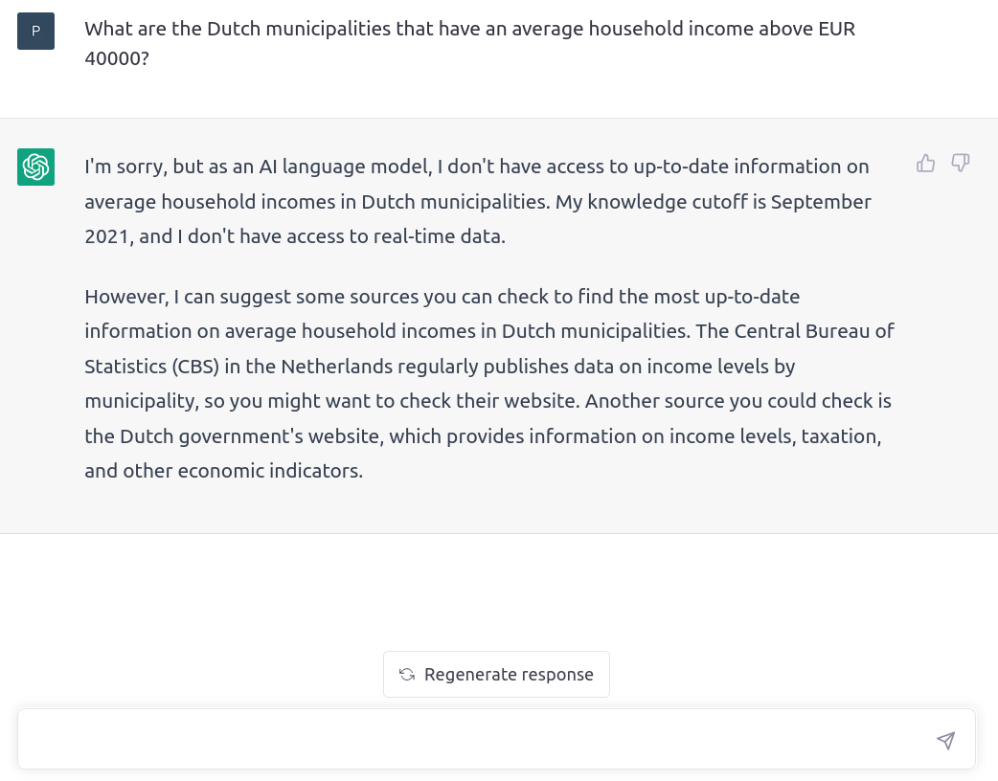
Notes:
At this point, stop the presentation, open the dataset file, and pose the question again: What are the Dutch municipalities that have an average household income above EUR 40000?
What are the challenges now?

Slide 18

File Input/Output (I/O)
Notes:
At this point, stop the presentation, open the dataset file, and pose the question again: What are the Dutch municipalities that have an average household income above EUR 40000?
What are the challenges now?

